Slide 1

P6 Renewvia - design
Taylor Boyd, Enming Li, Taylor Nguyen, Dharshan Rammohan

Slide 2
Members and Roles
Taylor Boyd
To research related works and propose methods to the team regarding initial parameterization and approach to determining pole count and locations (i.e. clustering, etc.).
Enming Li
To research related works & propose methods to the team regarding ways to find all possible grid designs (connectivity) within given constraints, assuming candidate pole count and locations have been determined.
*Note that we’ll all work on the team’s research paper along the way since we will all be doing our own research. We will also all work on the project's optimization once parameterization is finished.
Taylor Nguyen
To research related works and propose methods to the team regarding initial parameterization and approach to determining pole count and locations (i.e. clustering, etc.).
Dharshan Rammohan
To research related works & propose methods to the team regarding ways to find all possible grid designs (connectivity) within given constraints, assuming candidate pole count and locations have been determined.

Slide 3
Renewvia Energy
Our partner organization is Renewvia Energy. Our partner at Renewvia, Nicholas Selby, proposed bi-weekly meetings to check in on progress; these meetings have been scheduled for every other Wednesday 3-4pm UTC. The deliverables for the semester include an approach to solving the graph problem presented as well as documentation for the project (a research paper).

Slide 4
Renewvia Solar Mini-Grid Powerline Distribution networks design
The goal of our team is to produce a viable solution to the graph theory problem proposed by Nicholas Selby at Renewvia. More specifically, we hope to create a model for automating electricity grid pole and cable distribution such that the results include an optimal, cost-saving design for a given community. Further, we plan to start the project by focusing on its parameterization aspects as recommended by Nicholas. We will shift focus to optimization only when we feel like we’ve first been able to propose a worthwhile solution to finding all the possible grid designs given the basic constraints.

Slide 5
TimeLine
February - Parameterization
March - Optimization
April – Academic Paper & Project Handoff
Finish up parameterization piece of the project
Find candidate pole positions
Represent the problem with a Directed Acyclic Graph (DAG)
Feed DAG into a Graph Neural Network (GNN)
Finish up optimization piece of the project
Research optimization methods
Decide which approaches to test & implement them
Finish up the academic paper and handoff project to Renewvia
Complete methods, analysis, and conclusion of paper
Share paper, code, and all project materials

Slide 6
Architecture Details
Planned Technology/Ideas
Python
Python Libraries (scikit-learn, PuLP, etc)
Vercel
Disk Covering Problem
Integer Linear Programming
Simulated Annealing/Genetic Algorithm
Minimum Spanning Tree for Power Grid Design
Directed Acyclic Graph
Graph Neural Networks

Slide 7
Minimum Disk Covering Problem
Problem
Find the fewest number of circles with a radius of (r) to enclose all points within a plane
How it Applies
Finding the lowest number of poles to cover all houses, so all houses are within 20m of a pole
Using the fewest number of poles results in the lowest cost of poles resulting in fewest connections and possibly lowest cost

Slide 8
Integer Linear Programming
Uses
Mathematical optimization technique to solve problems with whole numbers
Using PuLP can solve the fewest number of circles it takes all points
Pros/Cons
Finds the exact optimal solution
Slow
Potentially not feasible in high-scale problems

Slide 9
Simulated Annealing/ Genetic Algorithm
Uses
Simulated Annealing starts with an initial solution and then changes it slightly with each iteration, and iteration passes converges to the solution
Starts with a group of solutions and then mutates and alters solution with each iteration optimizing based on fitness of solutions
Pros/Cons
Faster computation
Better with scaling problems
Requires tuning
Does not guarantee optimal solution

Slide 10
Directed Acyclic Graph
Use
Assuming fewest amount of valid poles are found, we can convert the problem to a graph problem by using DAGs
Advantages
This problem is naturally suited to this sort of structure, since we can make the poles the nodes and the wires the edges, and we know that we won’t have cycles within the power grid
This allows us to use efficient Dynamic Programming and Graph algorithms to find routes, or Ml algorithms like Graph NNs

Slide 11
Graph Neural Networks
Uses
Since we can turn the problem into a graph representation, we can make use of graph NNs
This allows us to use ML to optimize the problem subject to multiple constraints
Pros / Cons
The graph NN gives us an easily digestible structural representation of a NN, while allowing for multiple data features to be internalized in a single node / edge – GD can do the optimization for you!
If unbounded, the state space can grow exponentially, leading to compute constraints (Attention-based networks / Transformers help but are still susceptible to this)

Slide 12
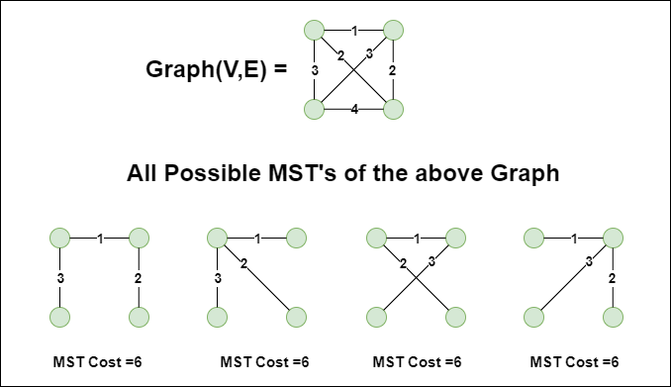
Minimum Spanning tree For power grid design
Under the assumption that all poles can be connected to each other, we can view the power grid as a fully connected graph with the poles as the vertices and connection as edges, with each edge possibly having different length. Thus, we can apply the minimum Spanning Tree algorithm. The algorithm finds a connection map such that all poles are connected using minimum number of connection, total connection length, and the graph will not have any closed loops.
MST example

Slide 13
Minimum Spanning tree For Pole connection
Under the assumption that all poles can be connected to each other, we can view the power grid as a connected graph with the poles as the vertices and connection as edges, with each edge possibly having different length. Thus, we can apply the minimum Spanning Tree algorithm. The algorithm finds a connection map such that all poles are connected using minimum number of connection, total connection length, and the graph will not have any closed loops.
MST example

Slide 14

Project Home Page
https://cs6510renewvia6.vercel.app/

Slide 15
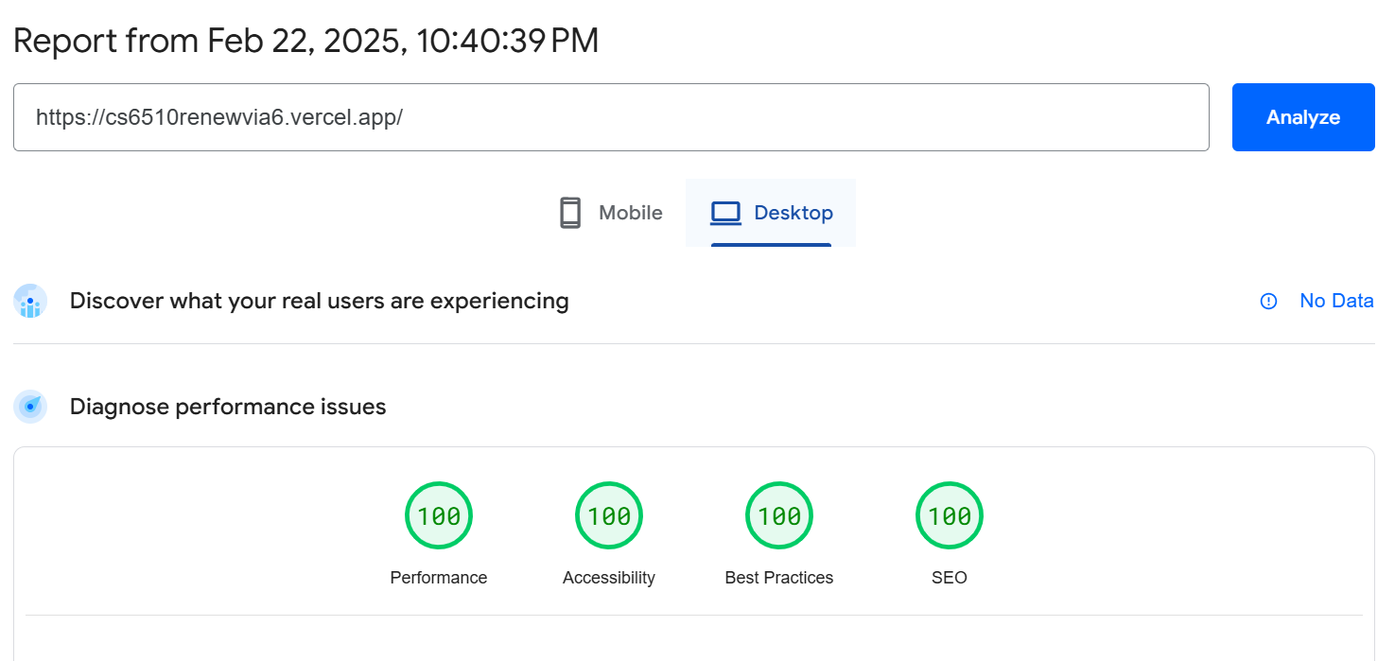

Project Homepage Screenshots
Desktop
Mobile

